Slide 1

Meta-learning on Heterogeneous Information Networks for Cold-start Recommendation
Yuanfu Lu¹, Yuan Fang², Chuan Shi¹
¹Beijing University of Posts and Telecommunications
²Singapore Management University

Slide 2
Outline
Motivation
MetaHIN
Experiments
Conclusions

Slide 3
Outline
Motivation
MetaHIN
Experiments
Conclusions

Slide 4
Cold-start Recommendation
Recommender System
collaborative filtering
content-based filtering
…
Cold-start Problem
New users or new items
The interaction data is very sparse
What about a new user or a new item?
Images from the Internet.

Slide 5
Existing Methods
Existing alleviations
Data level
Content-based
HIN-based
Model level
Meta-learning

Slide 6
Our Idea
Address the cold-start problem
at both data and model levels?
Exploit the power of both meta-learning at the model level and HINs at the data level
NON-TRIVIAL !

Slide 7
Challenges
C1: How to model HINs in the meta-learning setting?
Existing methods model HINs under traditional supervised or unsupervised learning settings
C2: How to model the general knowledge across tasks?
Previous work: Only adapt to new tasks (e.g., new users) from a globally shared prior
Our work: there exist multifaceted semantics brought by HINs

Slide 8
Outline
Motivation
MetaHIN
Experiments
Conclusions

Slide 9
Overall Framework of MetaHIN
C1:
Task construction augmented with semantic contexts
C2:
Semantic and task-wise adaptations

Slide 10
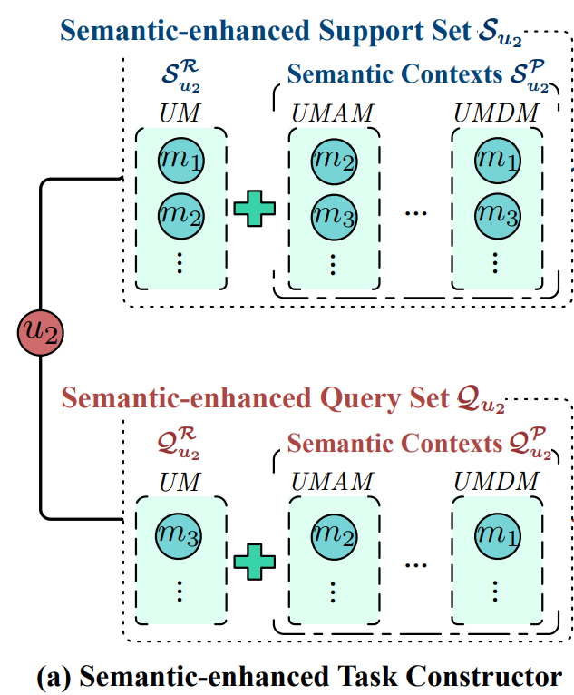
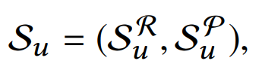
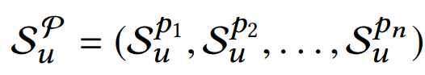
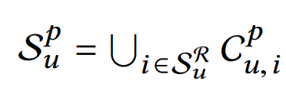
Semantic-enhanced Task Constructor
Support set of u
rated items
semantically related items
meta-path reachable items

Slide 11
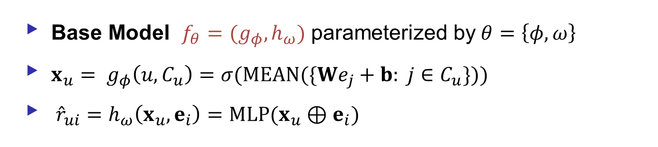
Co-adaptation Meta-learner
Base Model $f_{θ}=(g_{φ}, h_{ω})$ parameterized by$θ=\left\{φ,ω\right\}$
${x_{u}= g}_{φ}\left(u, C_{u}\right)=σ(MEAN(\{We_{j}+b: j∈C_{u}\}))$
${\hat{r}}_{ui}=h_{ω}\left(x_{u}, e_{i}\right)=MLP(x_{u}⊕e_{i})$

Slide 12
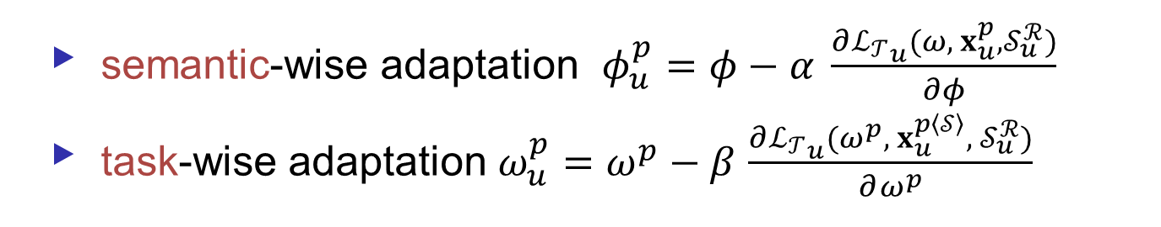
Co-adaptation Meta-learner
semantic-wise adaptation $φ_{u}^{p}=φ−α \frac{∂{ℒ_{𝒯}}_{u}(ω, x_{u}^{p},𝒮_{u}^{ℛ})}{∂φ}$
task-wise adaptation $ω_{u}^{p}=ω^{p}−β$ $\frac{∂{ℒ_{𝒯}}_{u}(ω^{p}, x_{u}^{p\left\langle 𝒮\right\rangle }, 𝒮_{u}^{ℛ})}{∂ω^{p}}$

Slide 13
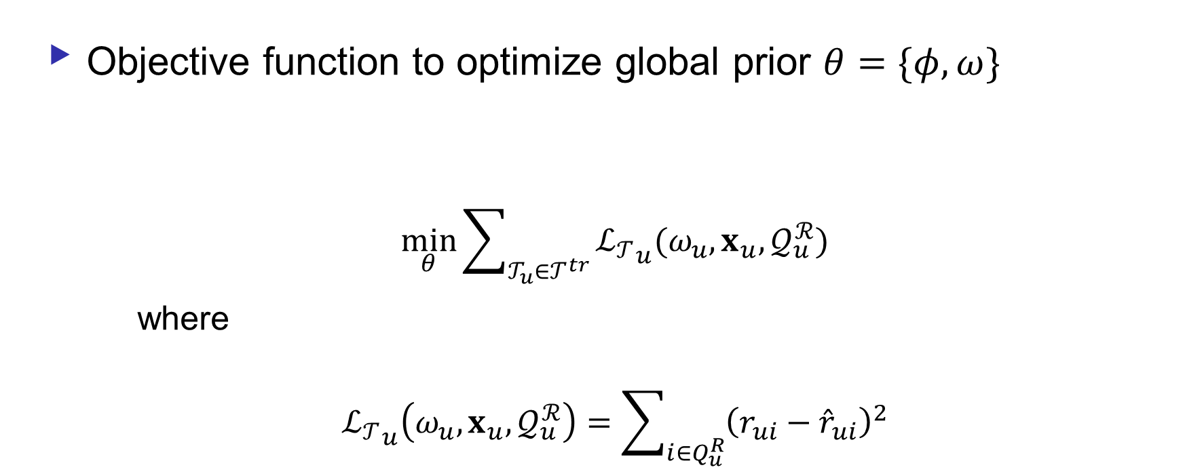
Optimization
Objective function to optimize global prior $θ=\{φ,ω\}$
$$\min_{θ}{\sum_{𝒯_{u}∈𝒯^{tr}}{{ℒ_{𝒯}}_{u}(ω_{u}, x_{u}, 𝒬_{u}^{ℛ})}}$$
where
$${ℒ_{𝒯}}_{u}\left(ω_{u}, x_{u}, 𝒬_{u}^{ℛ}\right)=\sum_{i∈Q_{u}^{R}}{{\left(r_{ui}−{\hat{r}}_{ui}\right)}^{2}}$$
rating prediction
model adapted to u
user preferences
(embeddings) adapted to u
ground truth
predicted rating

Slide 14
Outline
Motivation
MetaHIN
Experiments
Conclusions

Slide 15
Experiments
How does MetaHIN perform compared to state-of-the-art approaches?
How does MetaHIN benefit from the multifaceted semantic contexts and co-adaptation meta-learner?
How is MetaHIN impacted by its hyper-parameters?

Slide 16
Setup
Datasets
Dbook: #node: 42,070, #edge: 839,465
MovieLens: #node: 20,137, #edge: 1,019,817
Yelp: #node: 86,874, #edge: 1,429,218
3+1 scenarios
Three cold-start scenarios:
(UC) User Cold-start, i.e., recommendation of existing items for new users;
(IC) Item Cold-start, i.e., recommendation of new items for existing users;
(UIC) User-Item Cold-start, i.e., recommendation of new items for new users
One traditional scenario
recommendation of existing items for existing users

Slide 17
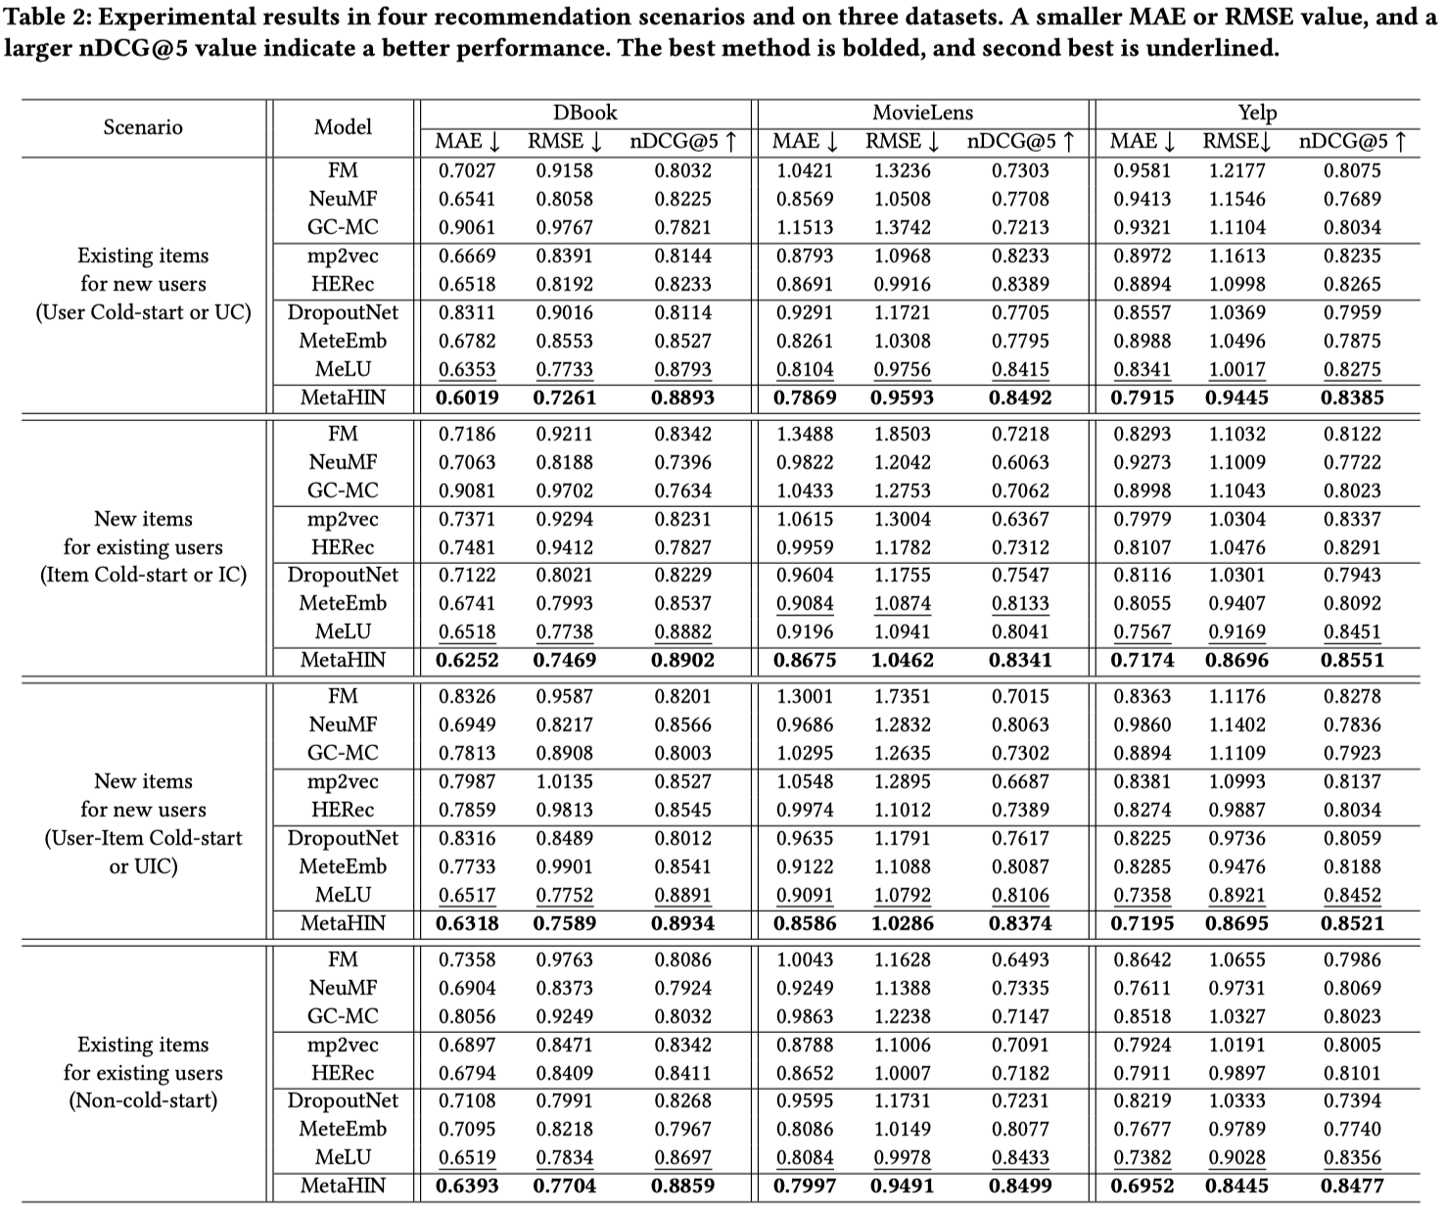
Performance Comparison (RQ1)
w.r.t. MAE
Dbook:
3.05-5.26%
MovieLens:
2.89-5.55%
Dbook:
2.22-5.19%

Slide 18
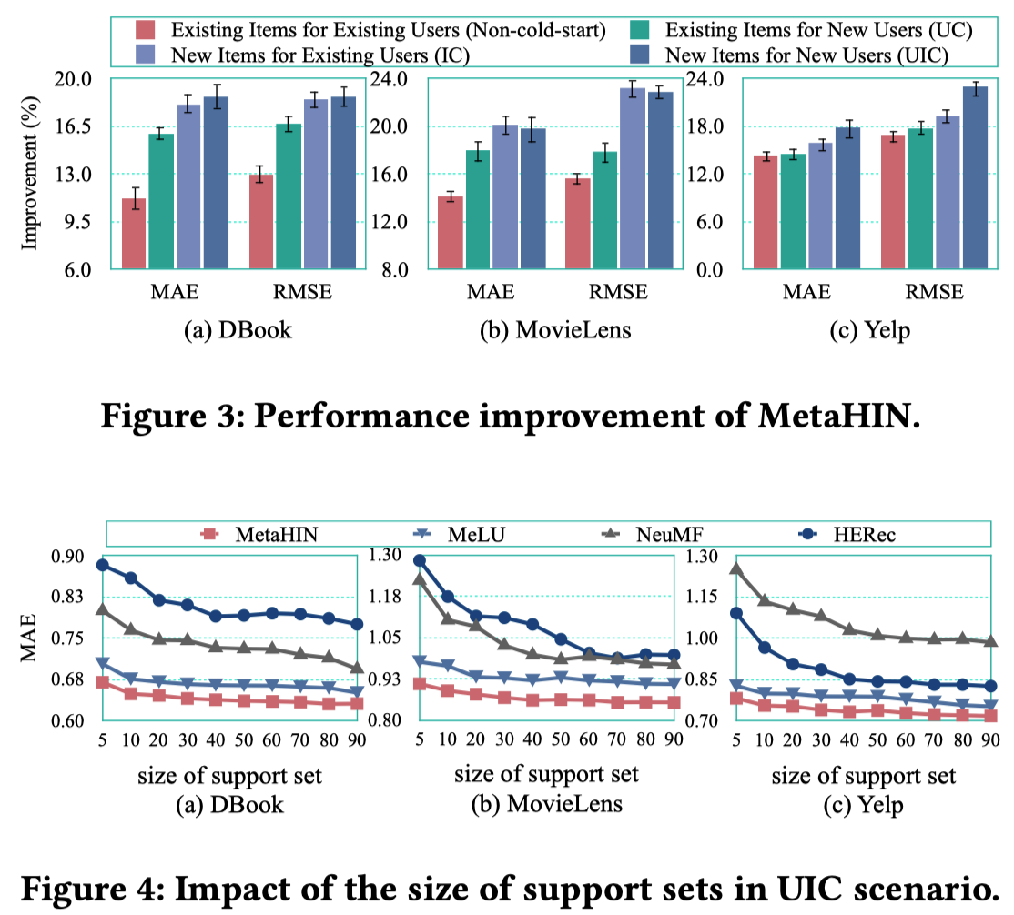
Performance Comparison (RQ1)
improvement
non-cold-start < UC ∼ IC < UIC
support set
the larger the set, the better the performance;
MetaHIN is robust to set size.

Slide 19
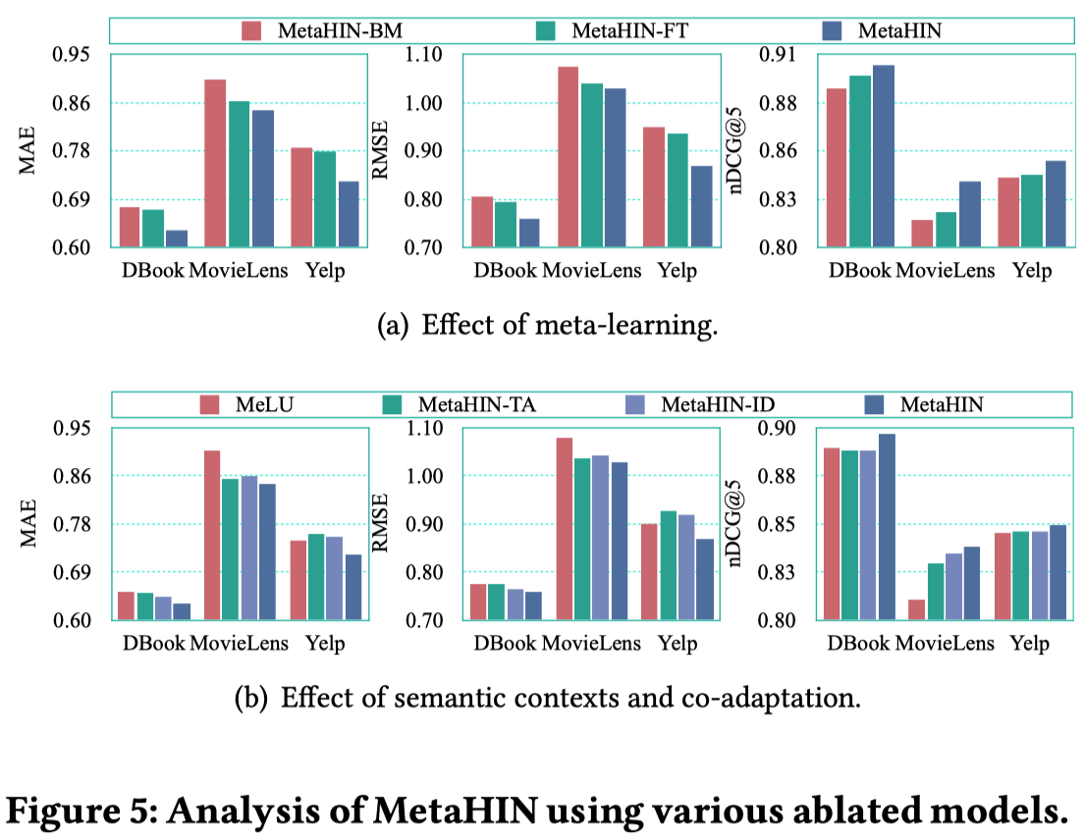
Model Analysis (RQ2)
MetaHIN-BM
base model without meta-learning
MetaHIN-FT
fine-tune the base model
MetaHIN-TA
only task-wise adaptation
MetaHIN-ID
independently adopts task-wise
adaptation

Slide 20
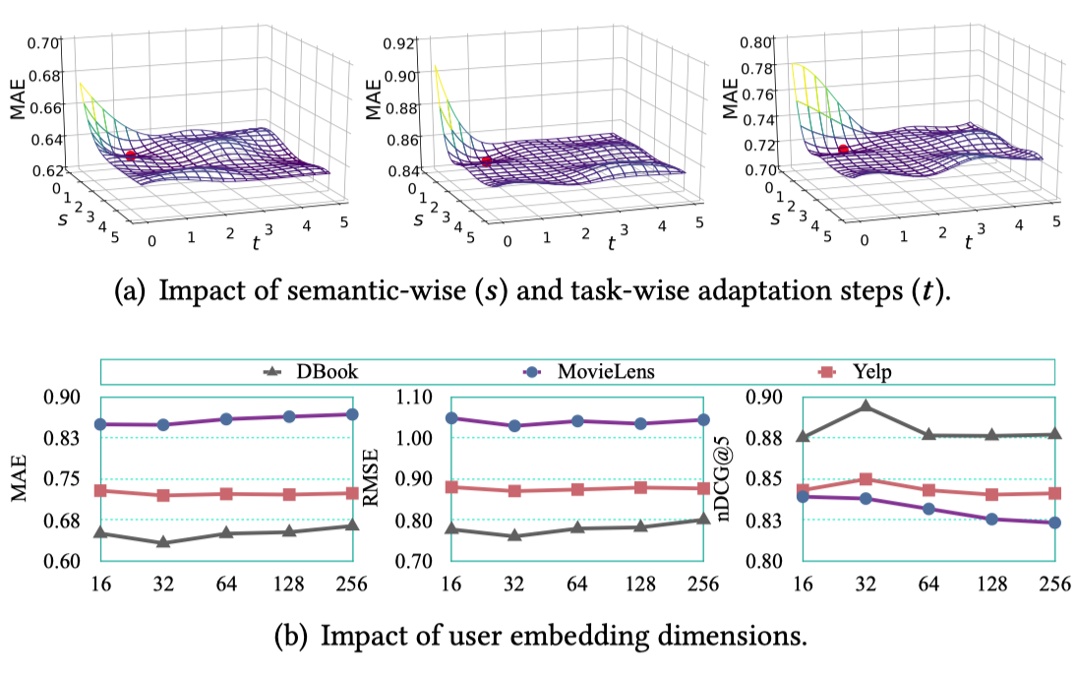
Parameter Analysis (RQ3)
Number of Co-adaptations
s and t are the number of semantic- and task-wise adaption step
Embedding Dimensions
d is the dimensions of user embeddings

Slide 21
Outline
Motivation
MetaHIN
Experiments
Conclusions

Slide 22
Conclusions
MetaHIN alleviates the cold-start problem at both data and model levels.
A semantic-enhanced task constructor to explore rich semantics on HINs in the meta-learning setting.
A co-adaptation meta-learner with semantic- and task-wise adaptions to cope with different semantic facets within each task.
Extensive experiments on three datasets.

Slide 23
Q&A
Thank you !
Q&A
More materials in
http://shichuan.org
http://www.yfang.site
https://yuanfulu.github.io

